Slide 1
Thursday 8th October 2020
Year 9 Parents’ Information Evening
Please click on link below to view the Loom video from Miss Mabey explaining these slides:
https://www.loom.com/share/4ffc0eb032324da7882258a1df441ba7
Miss G Mabey Year 9 Leader
g.mabey@testwood.hants.sch.uk

Slide 2
Welcome to Key Stage 4
English
Maths
Science
Business Studies
Spanish
French
Geography
History
Art
Drama
ICT
Sport
Food and Nutrition
Music
Dance
Computer Science
ICT
Photography
Core PE
PSHE

Slide 3
Target grades
These are where we think your child should aim to be in 2022
They are based on how they achieved at Key Stage 2 and compared with vast national database.
They are aspirational
They are only a guide
They are often exceeded

Slide 4
Attainment versus Attendance
Attendance | A8 | P8
97% - 100% | 52.89 | 0.21
95% - 96.9% | 42.05 | 0.13
93% - 94.9% | 41.68 | 0.08
90% - 92.9% | 34.88 | -0.11
0% - 89.9% | 30.18 | -0.62

Slide 5
Progress Checks and Reports
Every term we report on your child’s current level of attainment.
It is likely that they will be below their target for much of their courses
Crucial to look at attitude grades as a predictor of success. We will use colours to emphasise this

Slide 6
Key Dates
Progress Check 1 – 30th November 2020
Progress Check 2 – 15th March 2021
Year 9 Exams - w/b 19th April 2021
Progress Check 3 - 17th May 2021
Parents Evening - Thursday 7th June 2021

Slide 7
To be successful
Attendance and punctuality
Equipment
Resilience, determination, patience
Homework
Revision & preparation

Slide 8
Thursday 8th October 2020
Year 9 Parents’ Information Evening
Mrs V Ukahi– Head of English
v.ukahi@testwood.hants.sch.uk

Slide 9
The course outline…
Students will gain two whole GCSEs in August 2022 – English Language and English Literature
Students will take 4 exams. There are no controlled assessments or coursework.
At the moment, LANGUAGE or LITERATURE will count towards their college/university application- BUT Language is preferable
At the moment, a grade 4 is the cut off for some college courses BUT many will require a grade 5.
The elusive grade 9 is equivalent to A**. Only the top 4% in the country will achieve it.
There are no tiers of entry. Every student will take the same exam.

Slide 10
What we are doing…
Teaching Language and Literature together.
Mock exams – practice makes perfect.
4 lessons a week.
Embedding skills for the next two years.
Working as a department to regularly check our marking and feedback.
Choosing engaging texts to encourage participation- reading and studying around the exams
Positivity!

Slide 11
Year 9- GSCE Skills
Language Paper 1: Writing to Describe: 9/11
Literature Paper 1: Culture Text: Of Mice and Men
Literature Paper 2: War Poetry
Unseen Poetry Mock Exam- Spring
Literature Paper 1: Romeo and Juliet
Language Paper 1/Literature Paper 1: Heritage or Modern Fiction: Animal Farm, Martyn Pig or Curious Incident of the Dog in the Night Time
Language Paper 2: Comparing non-fiction: Captain Phillips
End of Year Language Exam- Summer

Slide 12
What you can do…
Encourage reading of an array of texts including pre 20th Century fiction
Mr Bruff - YouTube
Time students completing homework
Spellings and proof reading
Environment for working– lined paper, pens, highlighters, quiet space

Slide 13
How can you get in touch?
Email is best…
Head of English (9X1) – Mrs V Ukahi
Key stage 3 coordinator (9X2/9Y2) – Miss B Snook
English teacher (9X3) – Miss R White
English teacher (9Y1) – Mrs P Collis
English teacher (9Y3) – Mr Townsend
v.ukahi@testwood.hants.sch.uk
b.snook@testwood.hants.sch.uk
r.white@testwood.hants.sch.uk
p.collis@testwood.hants.sch.uk
d.townsend@testwood.hants.sch.uk
School Number: 02380 862146

Slide 14
Thursday 8th October 2020
Year 9 Parents’ Information Evening
Mrs Morley– Head of Maths
a.morley@testwood.hants.sch.uk

Slide 15
GCSE Maths at Testwood
In year 9 the pupils begin their GCSE journey.
The topics studied builds upon knowledge and skills gained from years 7 and 8.
Unlike other subjects there are tiers of entry for Maths - Higher or Foundation.
Set moves can take place but not as frequently as pupils have now started their GCSEs

Slide 16
Outline of GCSE Maths
Over the next 3 schools years pupils will study either for the higher or foundation Maths exam.
Class teachers are in the best position to decide which tier of entry should be studied by each pupil.
The difference between the tiers is the grades available.
Foundation Grades 1 to 5
Higher grades 4 - 9
.
All topics are planned for and covered so that pupils will be confident and secure of their mathematical understanding.

Slide 17
GCSE Maths 9-1
The Maths GCSE continues to challenge with problem solving in most questions.
Pupils will need to be fluent in skills learnt and how to apply this knowledge in unseen questions.
Questions continue to be multi layered perhaps two topics within one question often with no direct as to the route through to the answer.
Homework is a necessary element of Maths GCSE as it builds confidence and fluency with topics studied. At the moment this is set on google classroom.

Slide 18
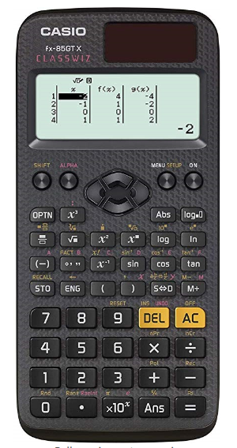
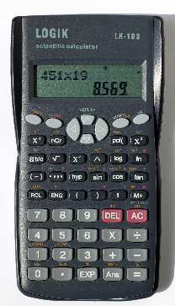
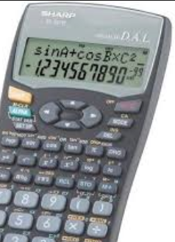
Support…
Having the correct equipment as crucial for students.
A scientific calculator will be required by each student.

Slide 19
Support at home….
The internet does provide a wealth of resources to help.
Asking about their homework.
Or do contact us at school

Slide 20
How can you get in touch?
Email is best…
Head of Maths – Mrs Morley
KS4 Coordinator – Mr Chikhungu
Maths Teacher – Mr Jenkins
Maths Teacher – Mr Ainsworth
KS3 Coordinator – Mr Terblanche
Assistant headteacher - Mr Murphy
School Number: 02380 862146
a.morley@testwood.hants.sch.uk
c.chikhungu@testwood.hants.sch.uk
c.jenkins@testwood.hants.sch.uk
n.ainsworth@testwood.hants.sch.uk
a.trebanche@testwood.hants.sch.uk
d.murphy@testwood.hants.sch.uk

Slide 21
Science
Mr Rothwell – Head of Science
g.rothwell@testwood.hants.sch.uk

Slide 22
Science Curriculum – the Journey
Combined Science 2 x GCSE
Separate Sciences 3 x GCSE
Hands on practical – required for exams
Learn How the Universe works.
(English & Maths Skills help!)

Slide 23
Structure of Assessment
Multi-layered questions
Knowledge 40%
Application 40%
Evaluation 20%
If you can only do the knowledge bit that’s a grade 3-3

Slide 24
Assessment
Double Award - 6 x 75 minutes long. (7.5Hrs)
Separate Science – 6 x 100 minutes long (10 Hrs)
Tiers of entry: Foundation 1-1 to 5-5 and Higher 4-3 to 9-9
Grade 5/6 will be the expectation for college depending on the course. Grade 6 for A Levels

Slide 25
Grades in Combined Science – 2 Tiers of Entry
Foundation
5-5
5-4
4-4
4-3
3-3
3-2
2-2
2-1
1-1
Higher
9-9
9-8
8-8
8-7
7-7
6-7
6-6
6-5
5-5
5-4
4-4
There is some overlap between the Higher & Foundation tiers

Slide 26
Maths Skills…
Maths content in papers
Biology 10%
Chemistry 20%
Physics 30%
This is greater than the last course.

Slide 27
Our support for your child…
Keywords – We get them to Talk the Talk
Revision technique
Practise in applying
Meet real Scientists
Revision Classes
Exam Questions – regular practice in class

Slide 28
Our support for your child…
Revision Guides
CGP revision guides, workbooks and practice exam papers.
https://www.cgpbooks.co.uk/secondary-books/gcse/gcse-science-aqa
Summative Examinations
Exam conditions
Additional resources
Kerboodle, BBCBitesize
www.freesciencelessons.com

Slide 29
How can you support your child…
Revision Guides & work books
Please buy them and ensure they use them
Encourage them to ideally make (or buy) revision cards
Required Practicals & Equations
Help us ensure they learn them – it’s essential
www.freesciencelessons.com
Regular Practise
Ensure they are going over older topics regularly at home
Summative Examinations
Try these under Exam conditions
Available on the internet

Slide 30
How can you get in touch?
Email is best…
Head of Science – Mr Rothwell
Second in Science – Mr Batt
Science Teacher – Miss M Chadwick
Science Teacher – Mrs Hodgson
Science Teacher – Mrs Lancaster-Adams
Science Teacher – Miss J Marlio
Science Teacher – Mr Shipsides
School Number: 02380 862146
g.rothwell@testwood.hants.sch.uk
a.batt@testwood.hants.sch.uk
m.chadwick@testwood.hants.sch.uk
c.hodgson@testwood.hants.sch.uk
k.lancasteradams@testwood.hants.sch.uk
j.marlio@testwood.hants.sch.uk
m.shipsides@testwood.hants.sch.uk

